Slide 1
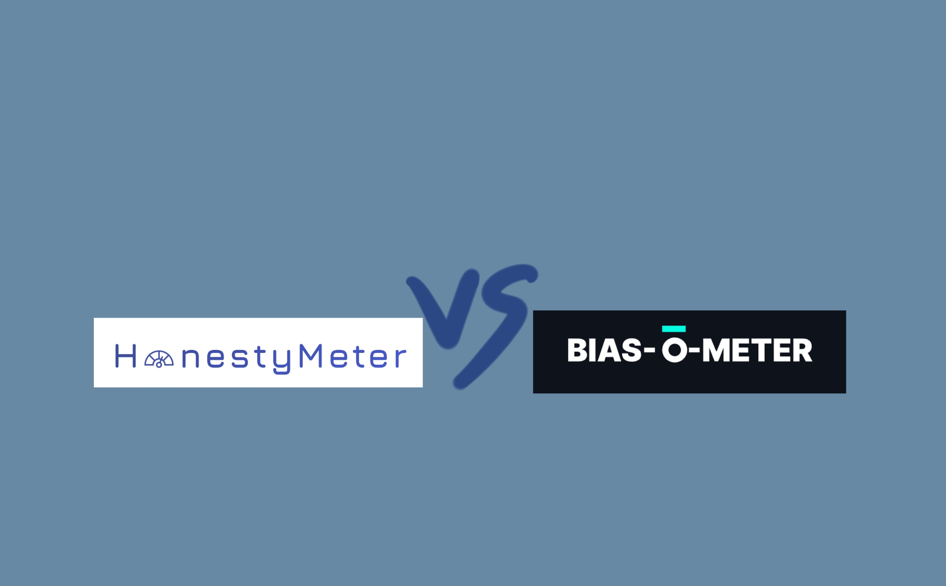
Comparative Analysis of Political Bias Detection Results in the “HonestyMeter” and “Bias-o-meter” AI Tools
Vasilisa Lukashevich
Student ID: 12690005
Research Methods and Professional Practice Module (May 2023)
Research Proposal Presentation for Unit 10

Slide 2
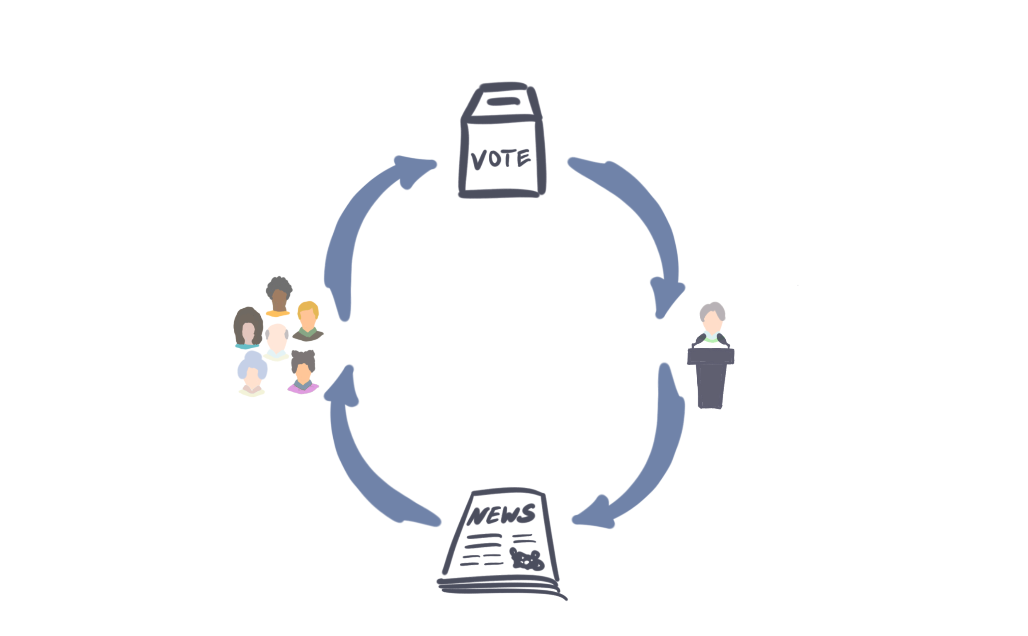
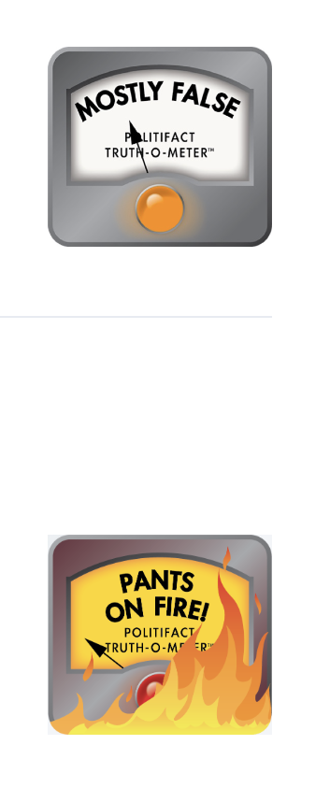

Contribution to the discipline
In democratic countries,
political knowledge
is considered
to be a cornerstone
of the state
(Carpini & Keeter, 2022)

Slide 3
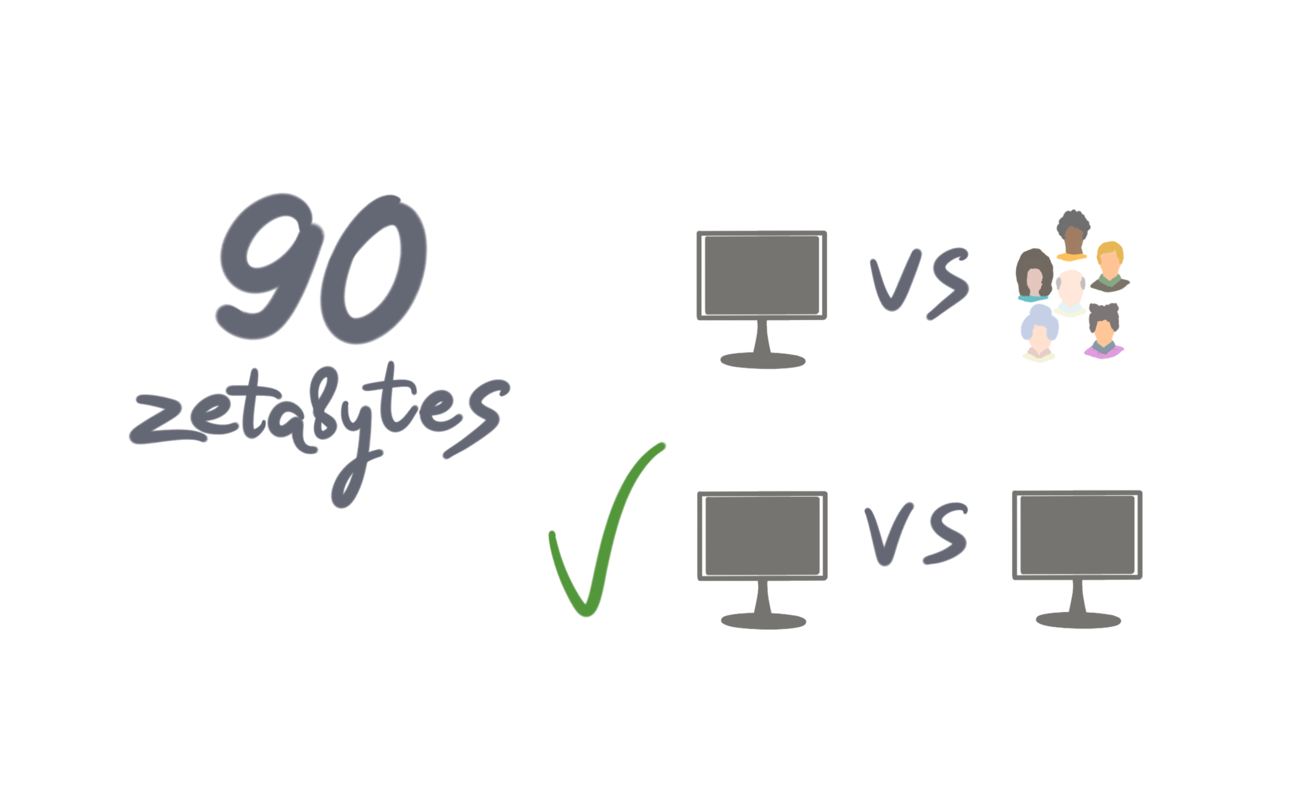
Contribution to the discipline
(Jang et al., 2018)

Slide 4
Research Question
In what scales do the results of the two
instruments vary from each other
on the same texts (and why)?

Slide 5
Aims
1. To identify topics of news articles where the results of the observed tools are either similar or different.
2. To analyse and interpret the differences in the results, exploring the most and least bias-sensitive topics in modern politics.

Slide 6
Objectives
1. To discuss the reasons for the mismatched results, e.g.:
data source discrepancies,
inappropriate documentation,
weak connection to the current political context (Paullada et al., 2021).
2. To evaluate basic reasons for inherent political bias in tools.
3. To create visualisations that illustrate the differences between the results.

Slide 7
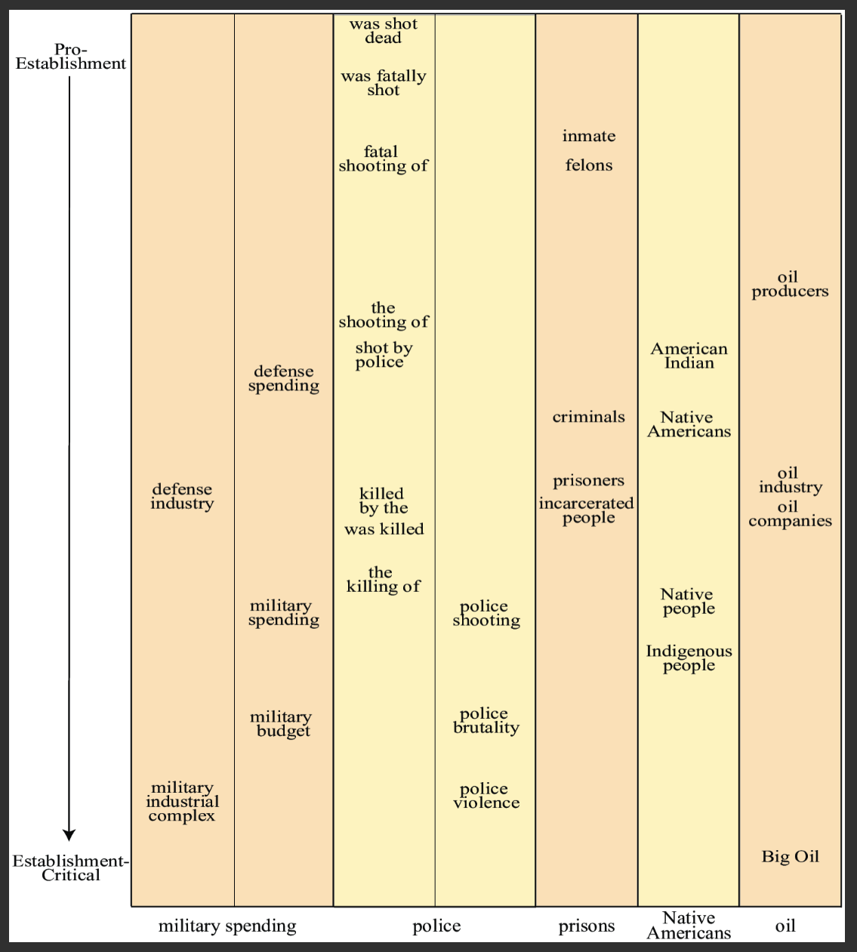
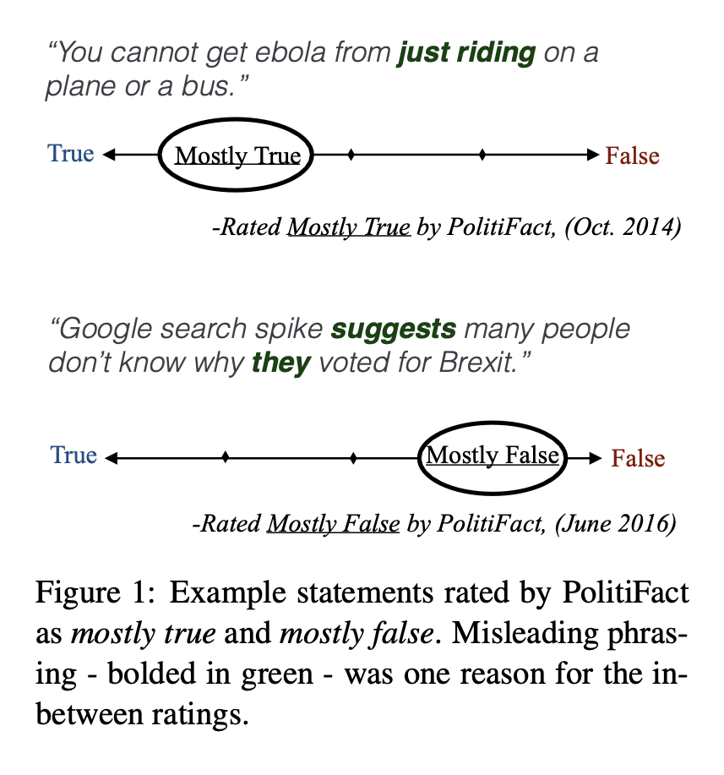
Key literature related to the project
Section one. Political biases in news texts
(D’Alonzo & Tegmark, 2022) (Rashkin et al., 2017)

Slide 8
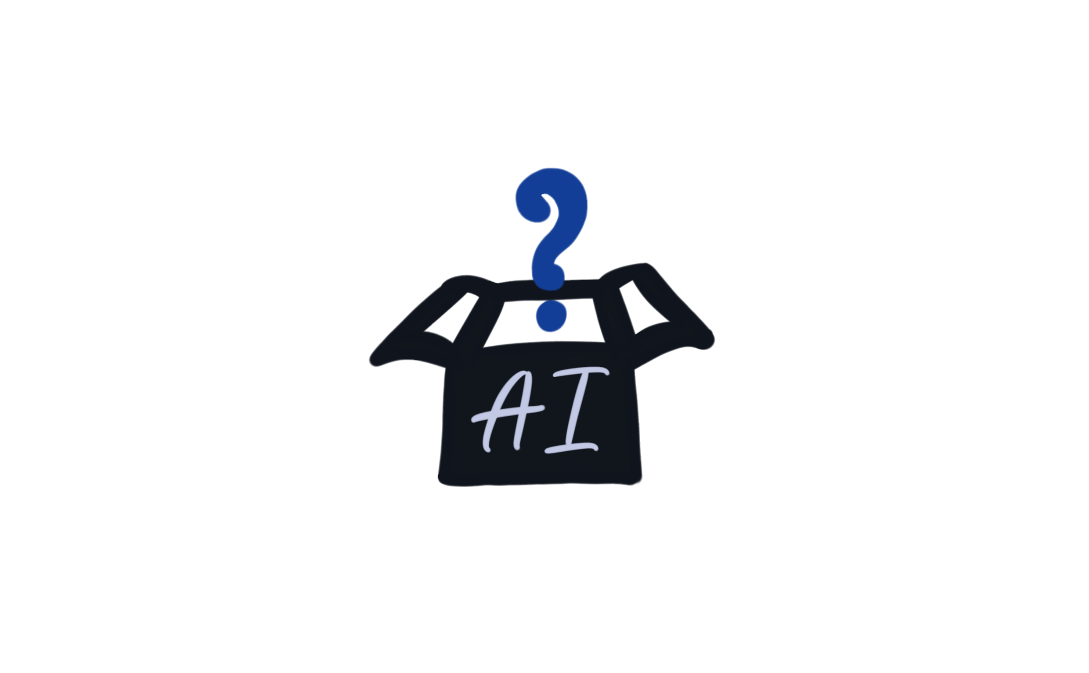
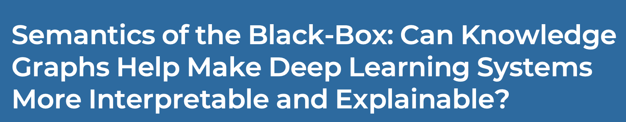
Key literature related to the project
Section two. Deep algorithms and their secrets
(Gaur et al., 2021)

Slide 9
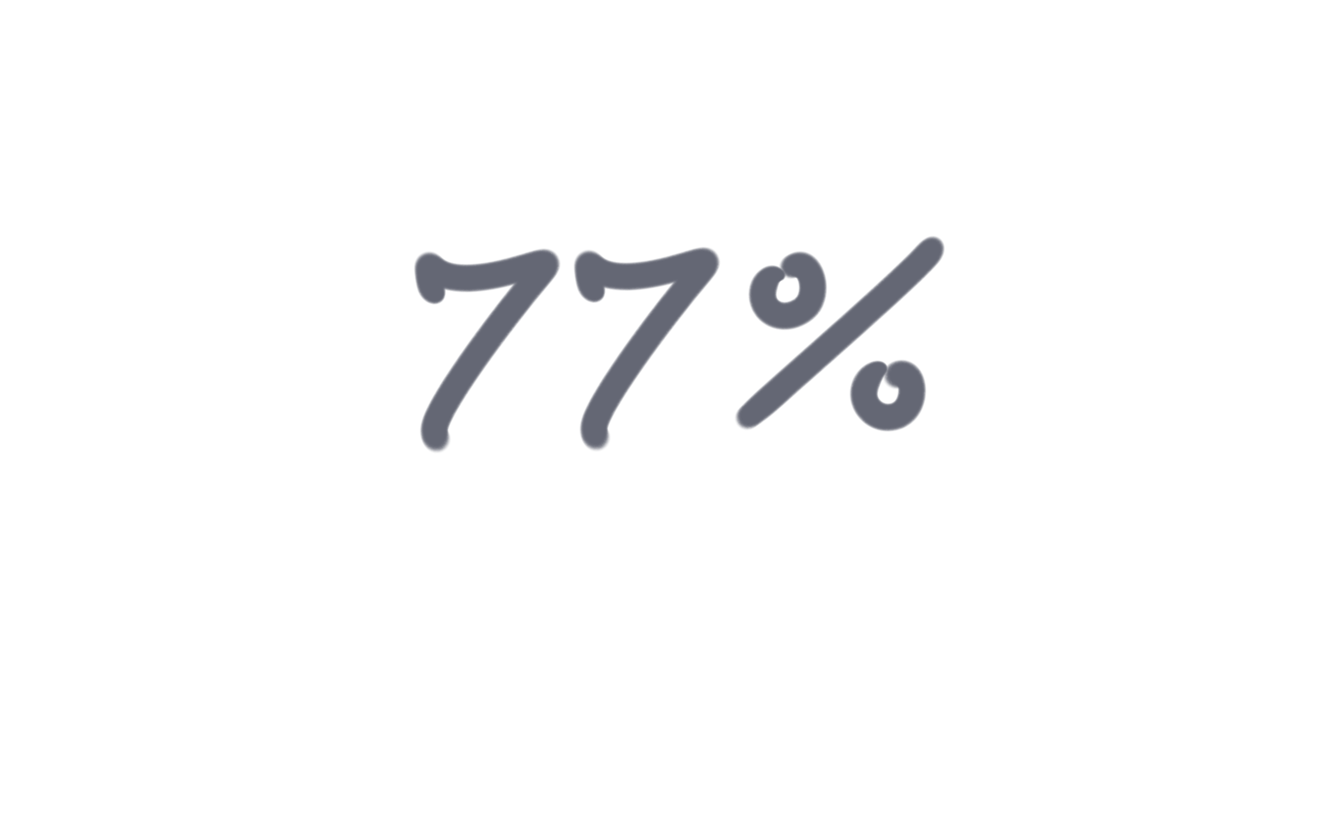
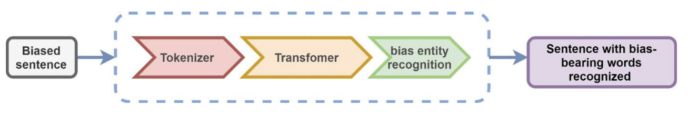
Key literature related to the project
Section three. The similar project
Dbias assists in detecting and mitigating biases in NLP tasks.
(Raza et al., 2022)

Slide 10
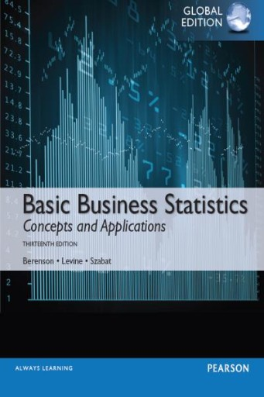
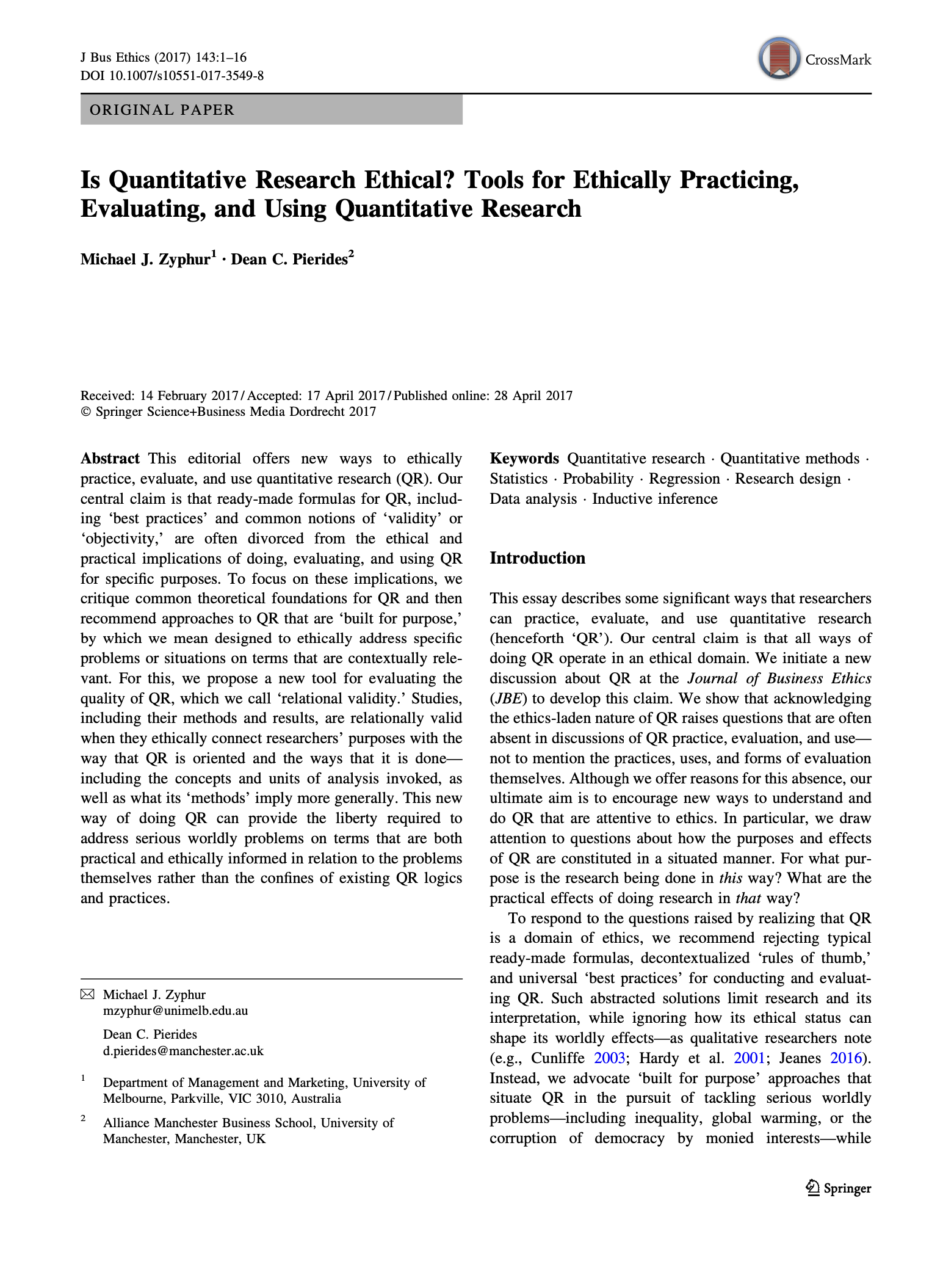

Key literature related to the project
Section four. Quantitative research
(Berenson et al., 2015) (Zyphur & Pierides, 2017) (Claydon, 2015)

Slide 11
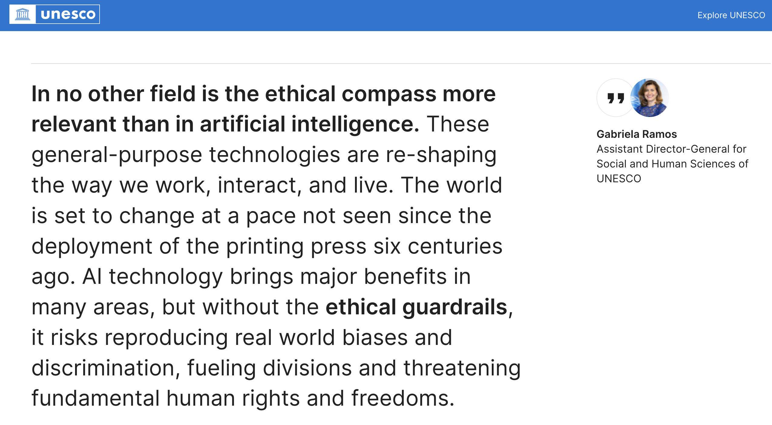
Ethical considerations and risk assessment

Slide 12
Ethical considerations and risk assessment
AI algorithms are not neutral
Results obtained from both tools may yield inappropriate conclusions
- Responsibility for the scores lies with AI creators (Dignum, 2020)
- Political discussions are contentious (Thompson, 2018)
The possibility of unconscious bias by the researcher exists
(Zyphur & Pierides, 2017; Claydon, 2015)

Slide 13
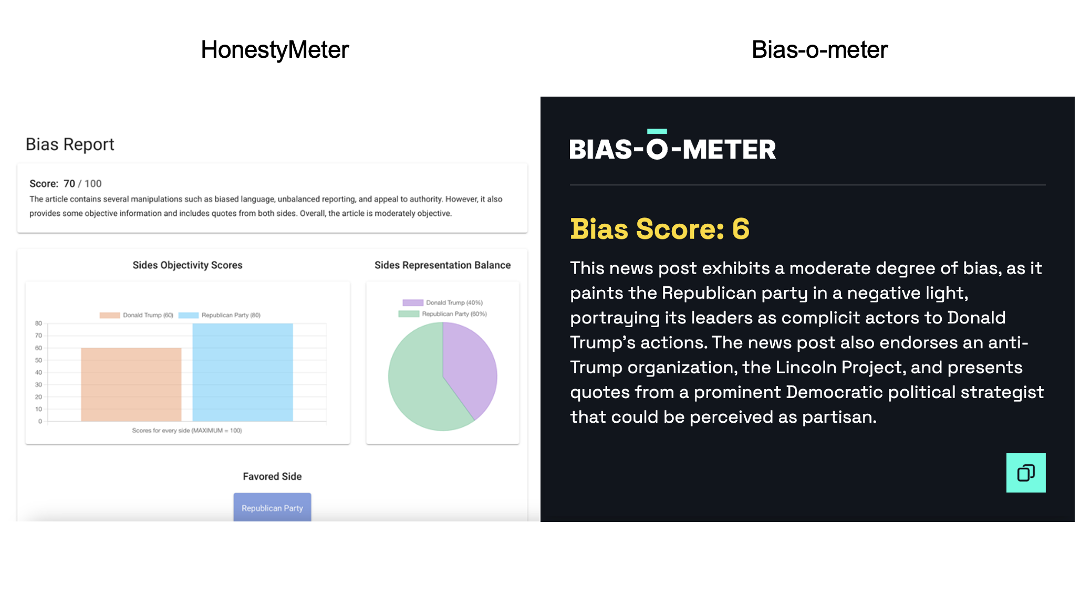
Methodology

Slide 14
Standardising the results
HonestyMeter = 100 - Score Result
e.g. if Score = 70, then we write down 30
Bias-o-meter = Score Result * 10
e.g. if Score = 6, then we write down 60

Slide 15
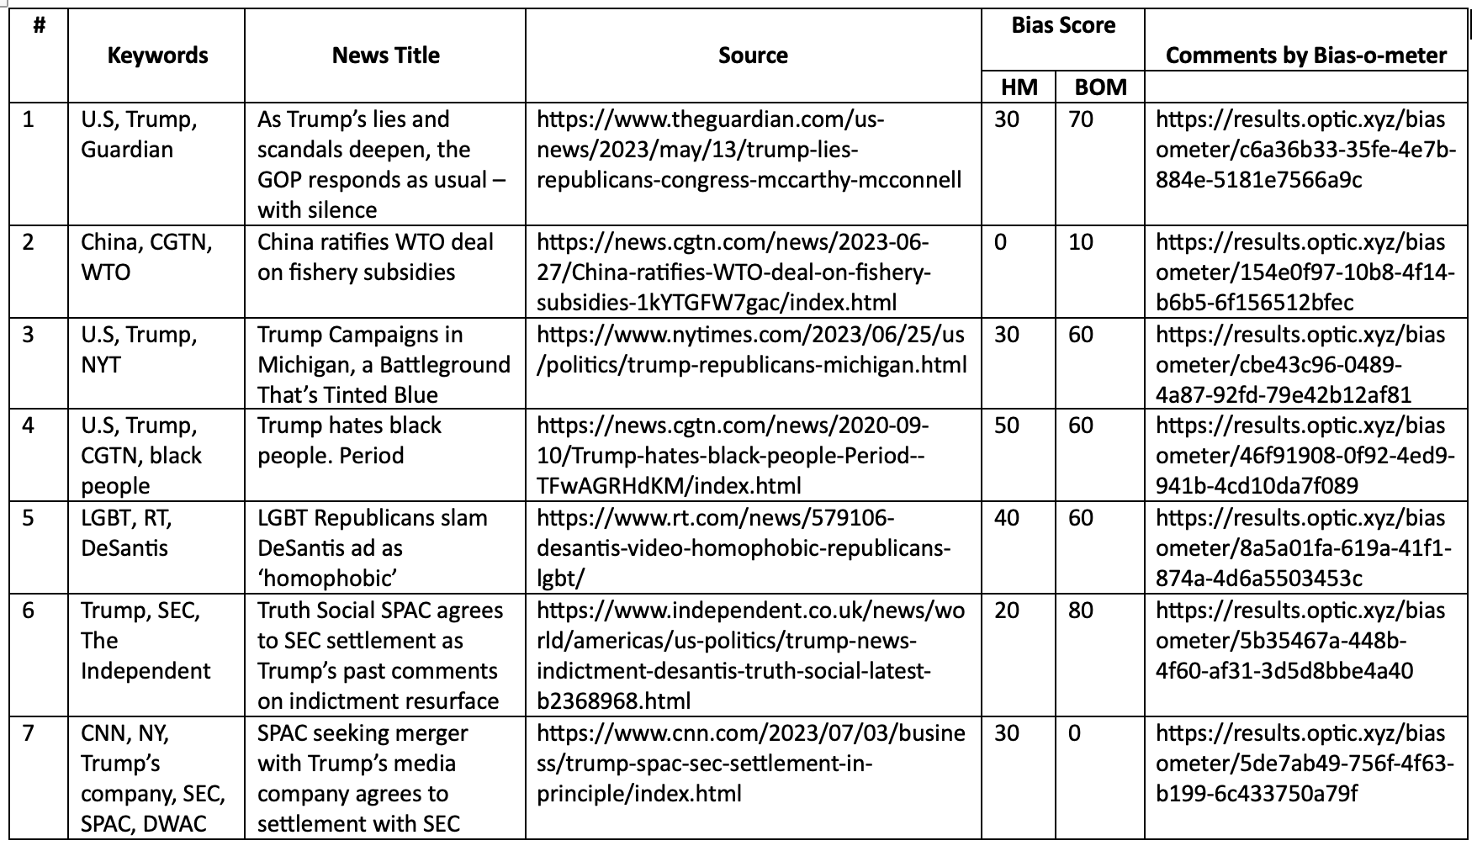
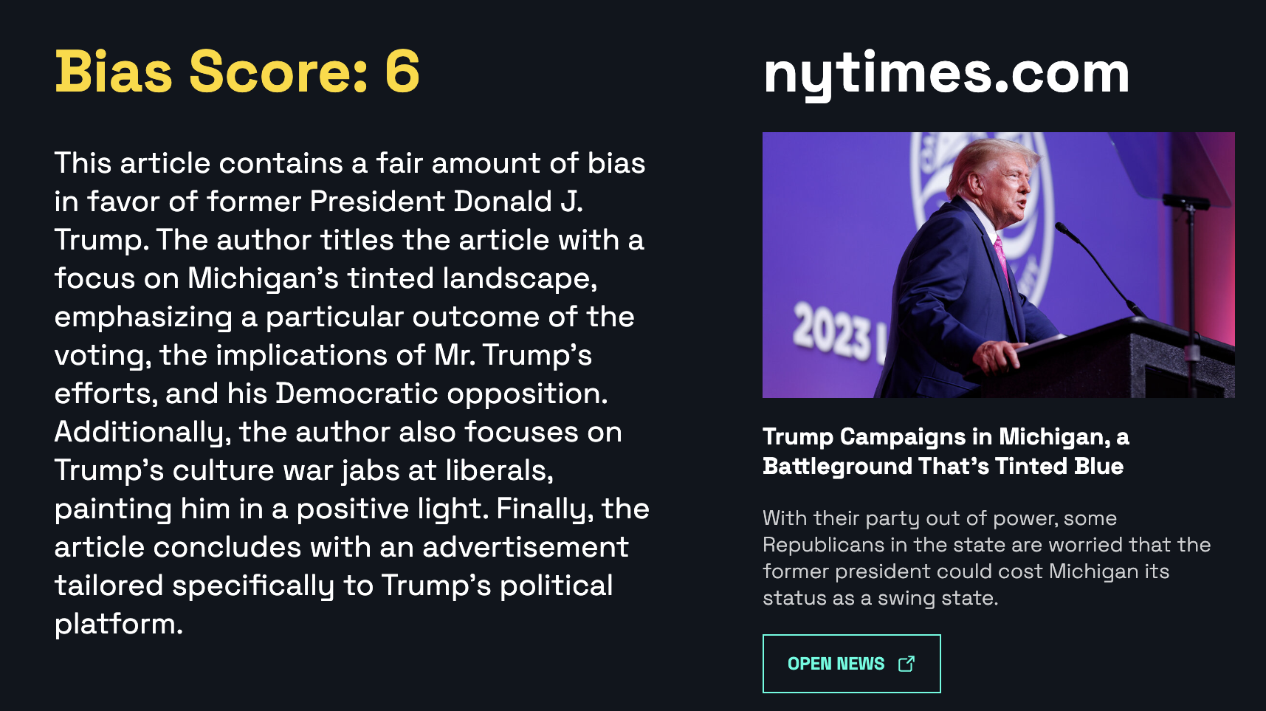
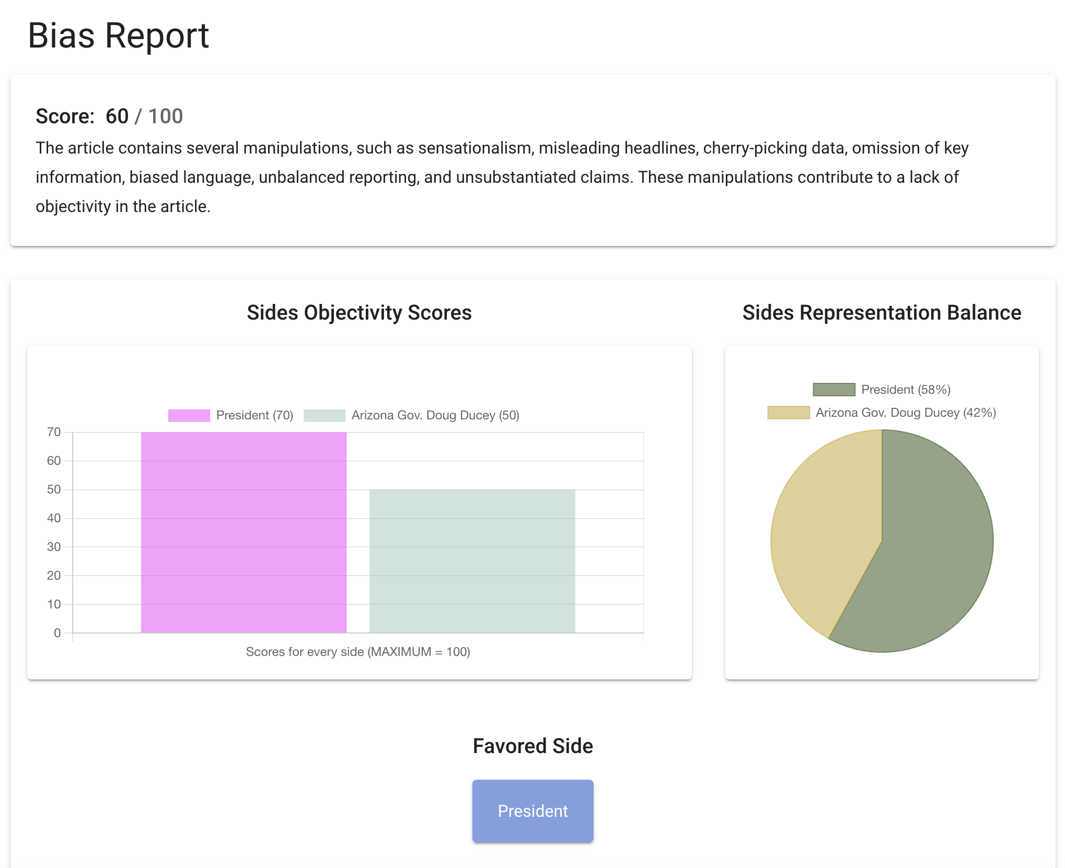
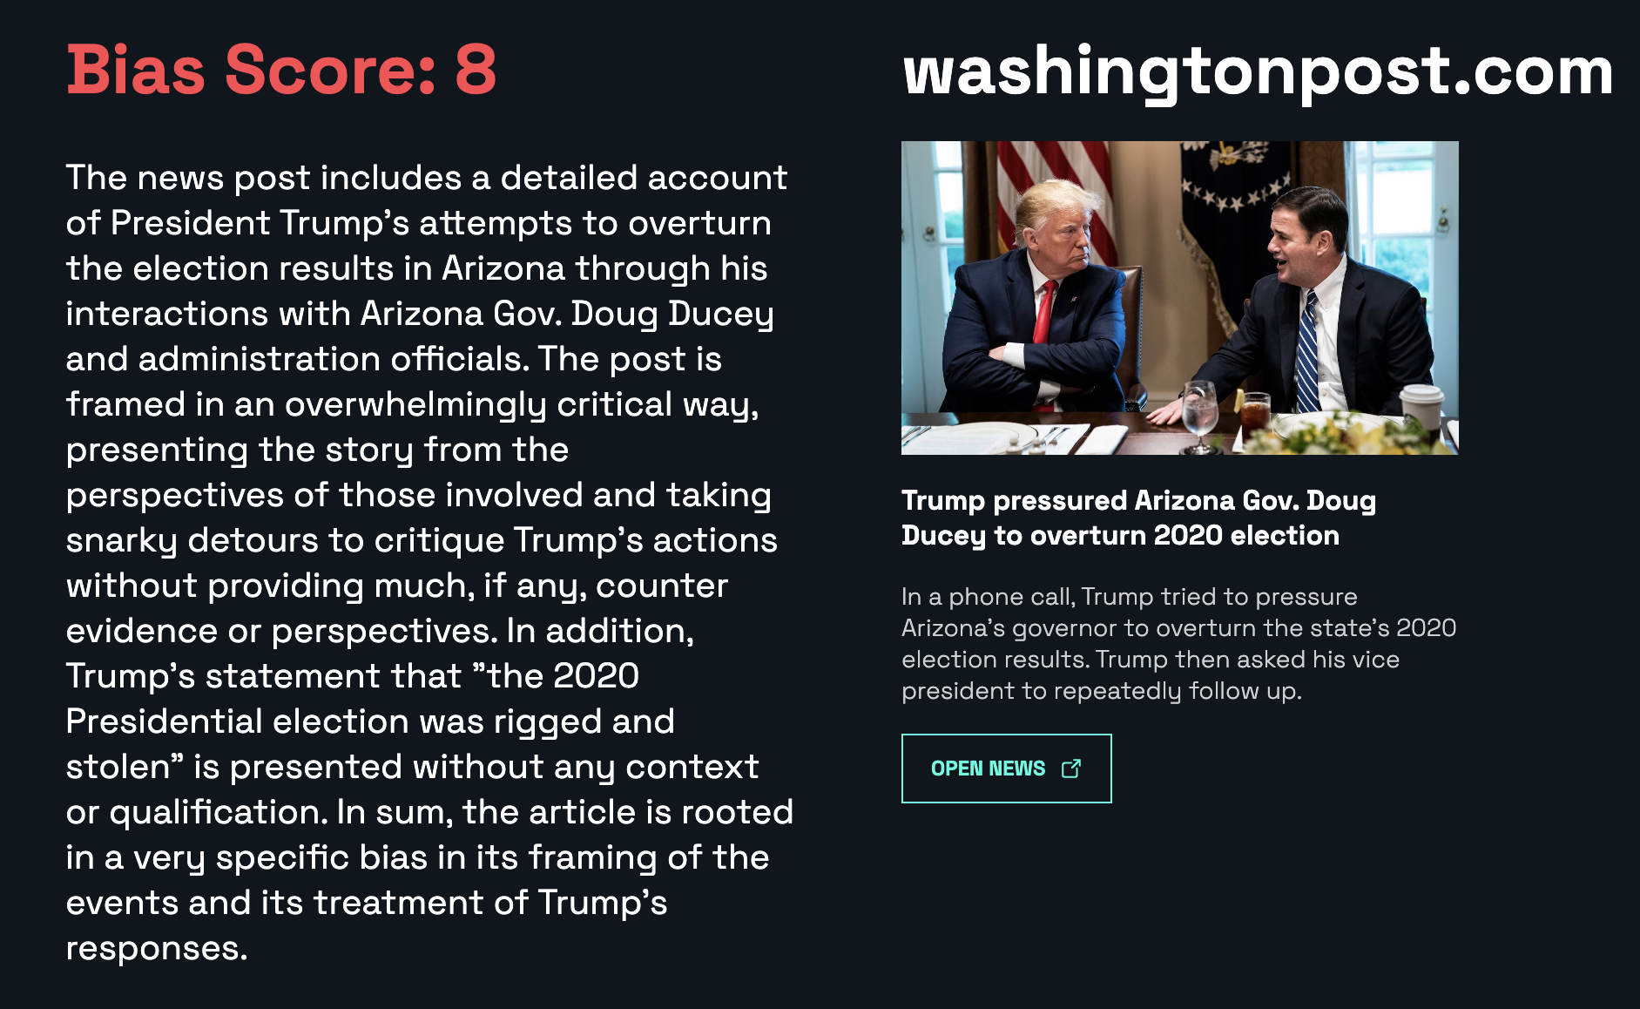
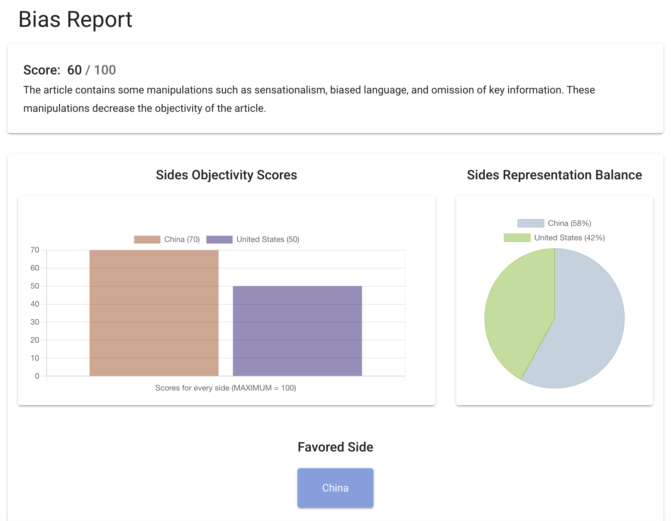
Example of practical comparison

Slide 16
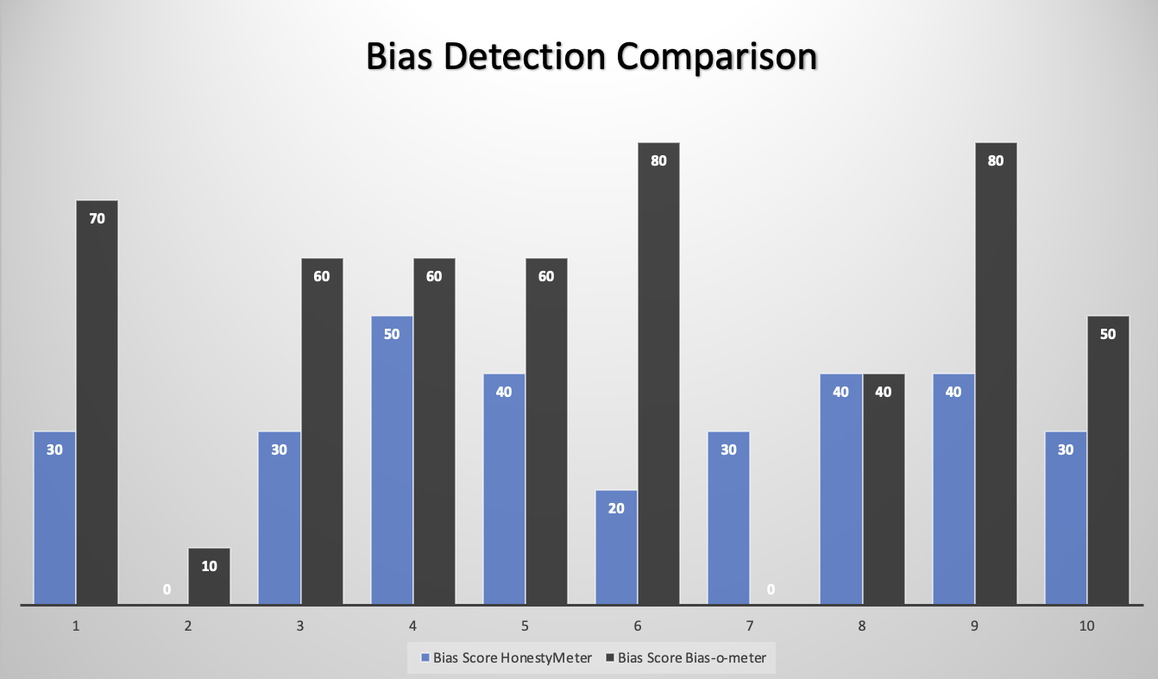
Example of practical analysis
HonestyMeter Mean: 31
Bias-o-meter Mean: 51

Slide 17
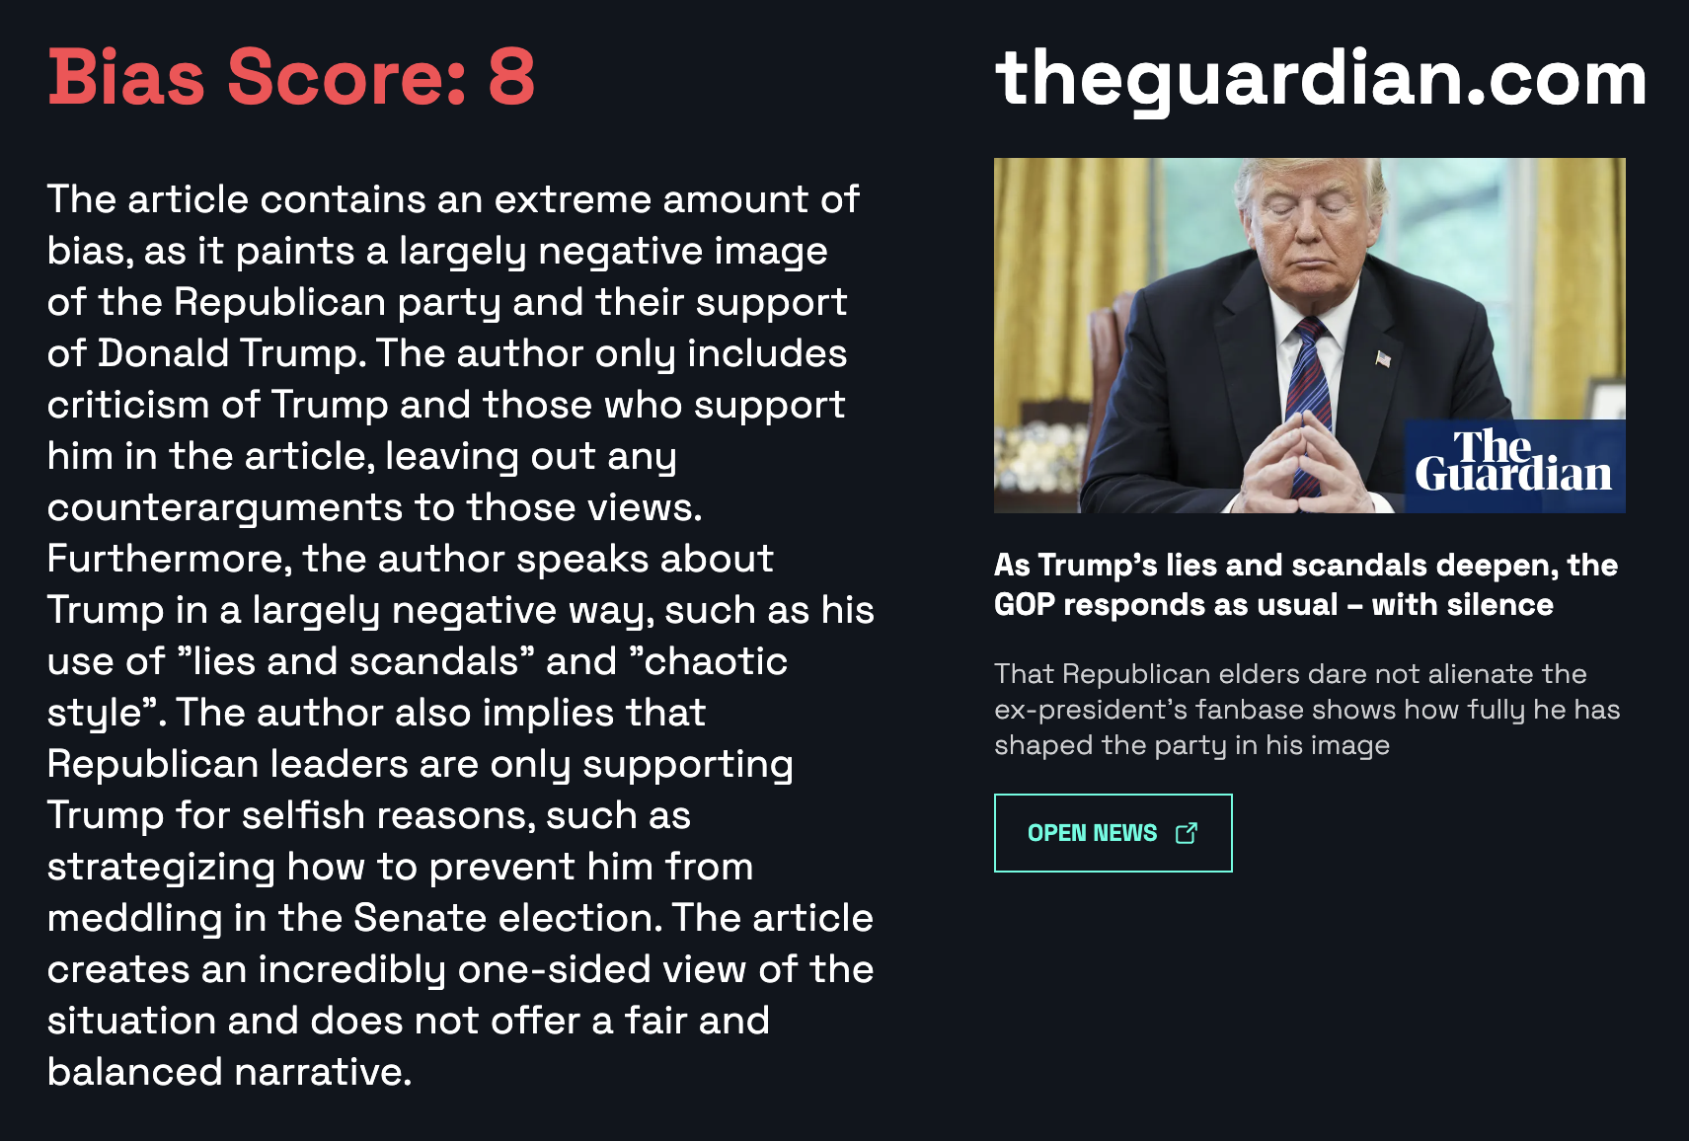
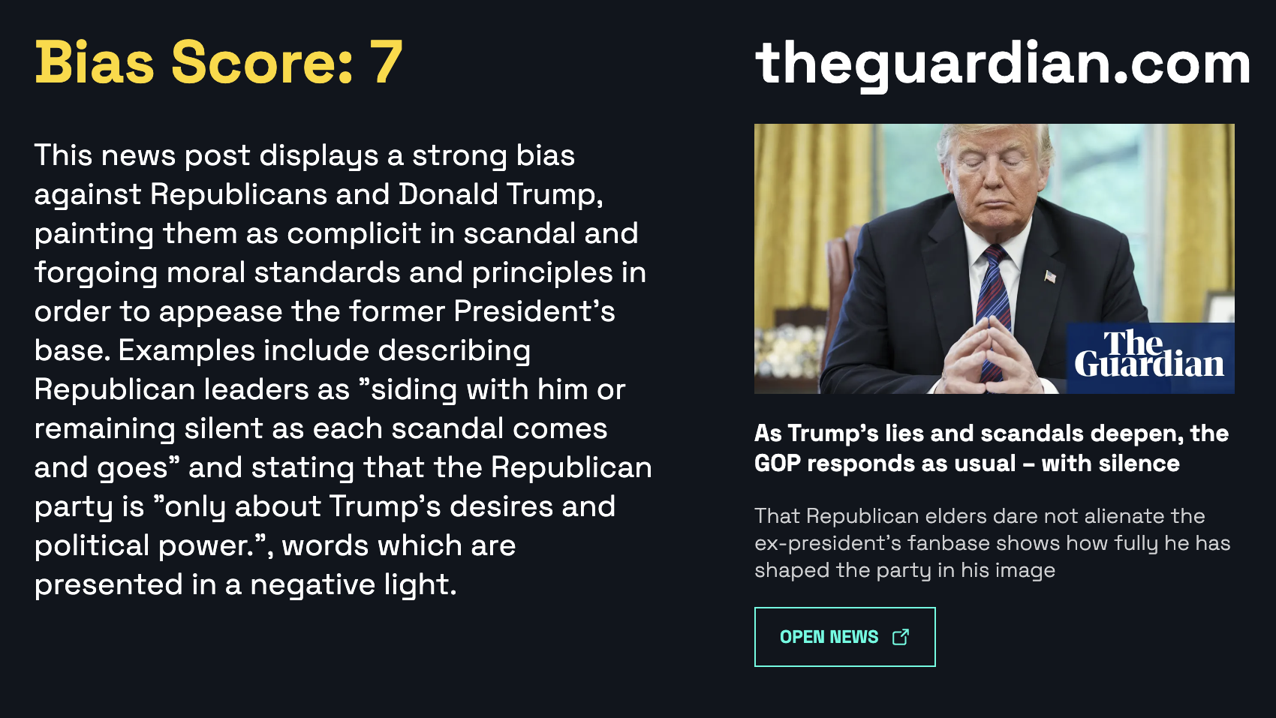
The initial pitfalls in practical work
- Unstable results on the same text (Bias-o-meter)
The scores on the same article in 30 seconds interval

Slide 18
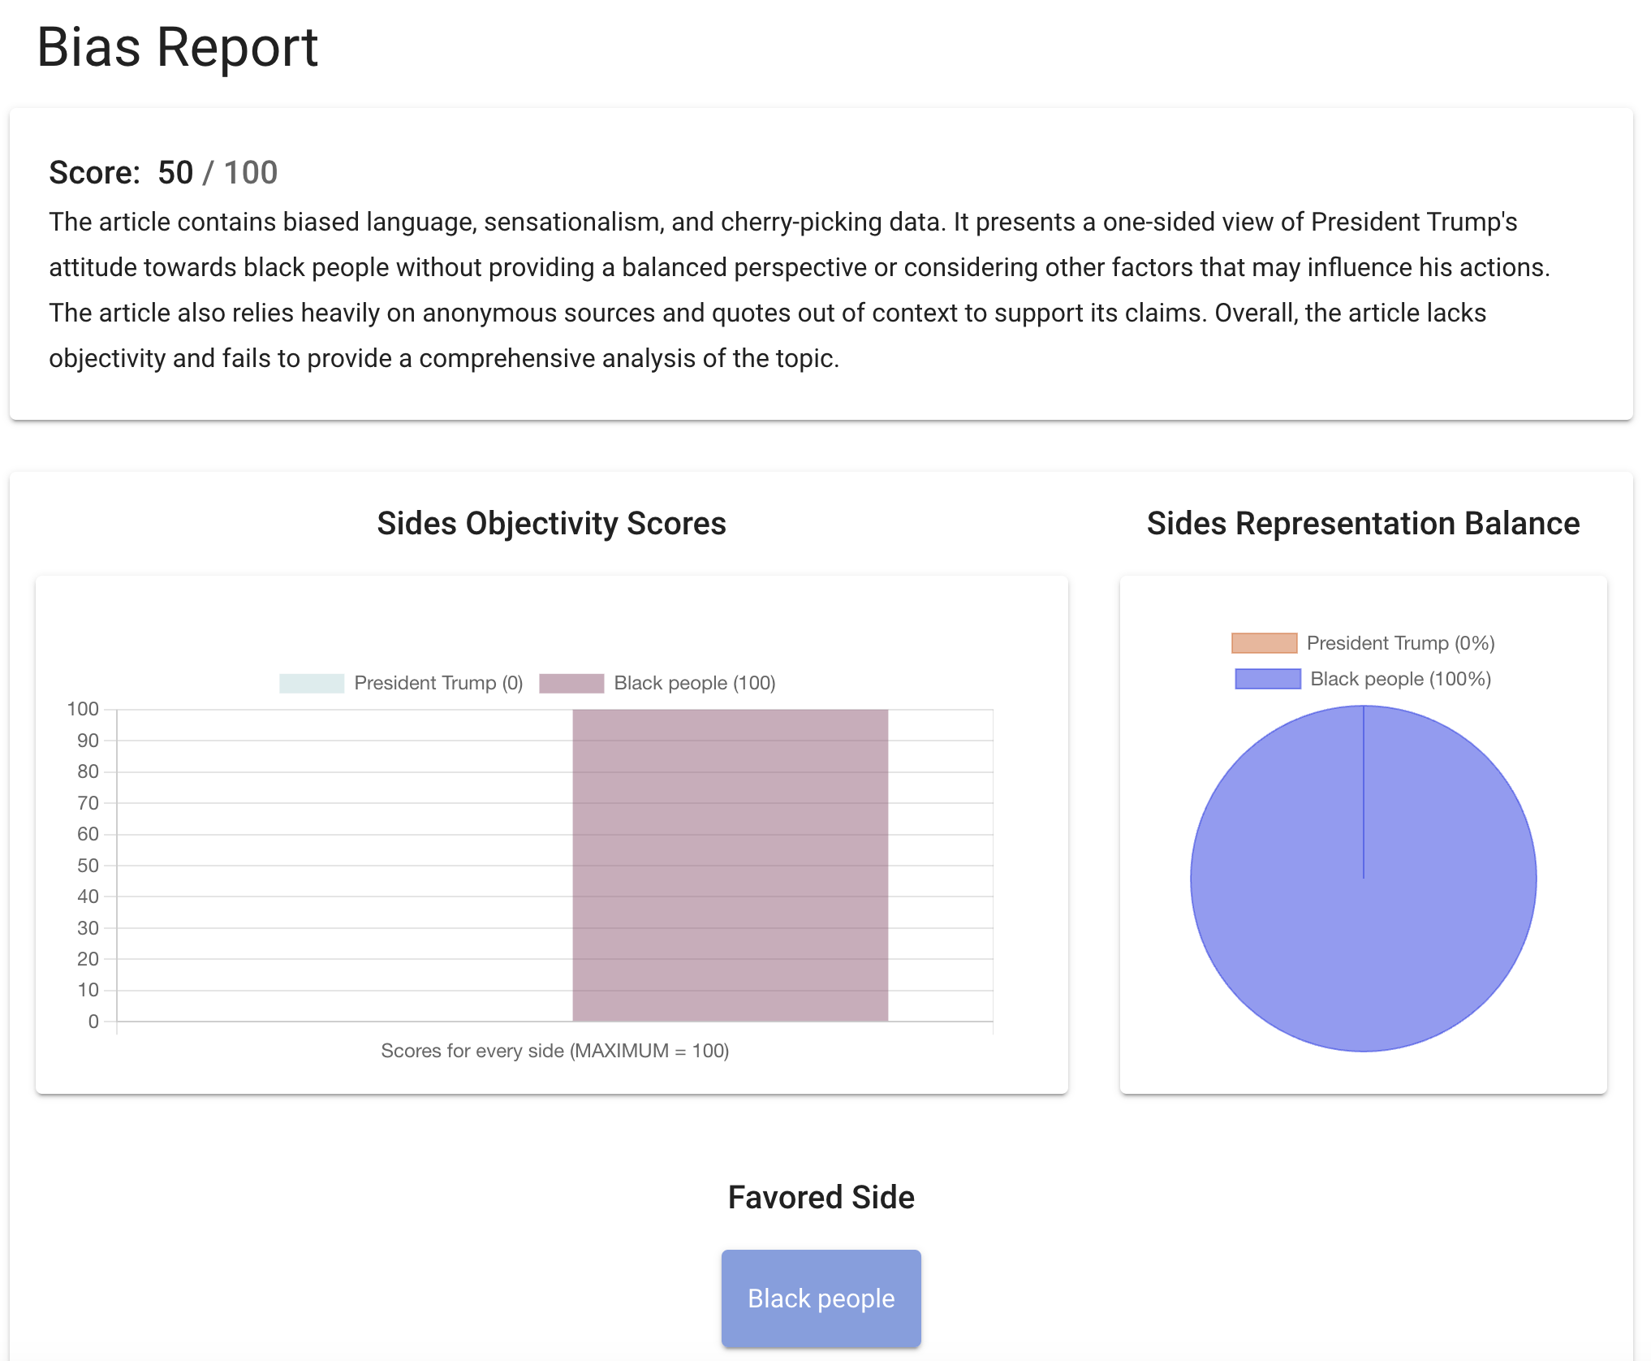
The initial pitfalls in practical work
- “Mitigating” final output score (HonestyMeter)

Slide 19
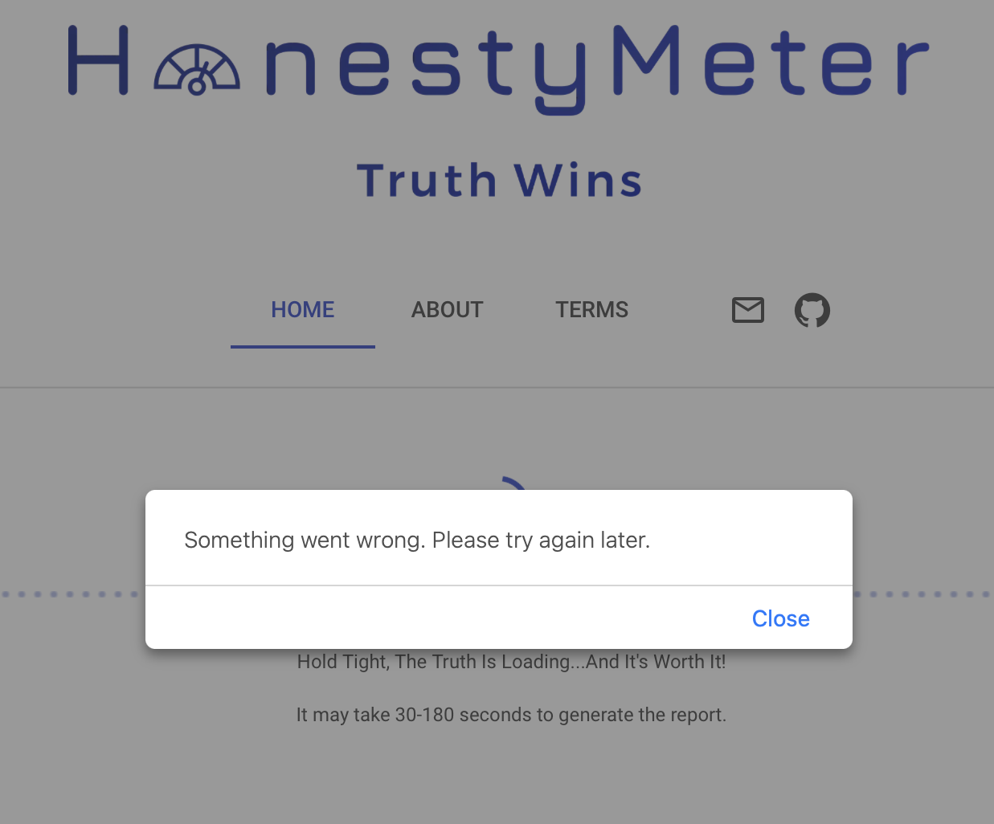
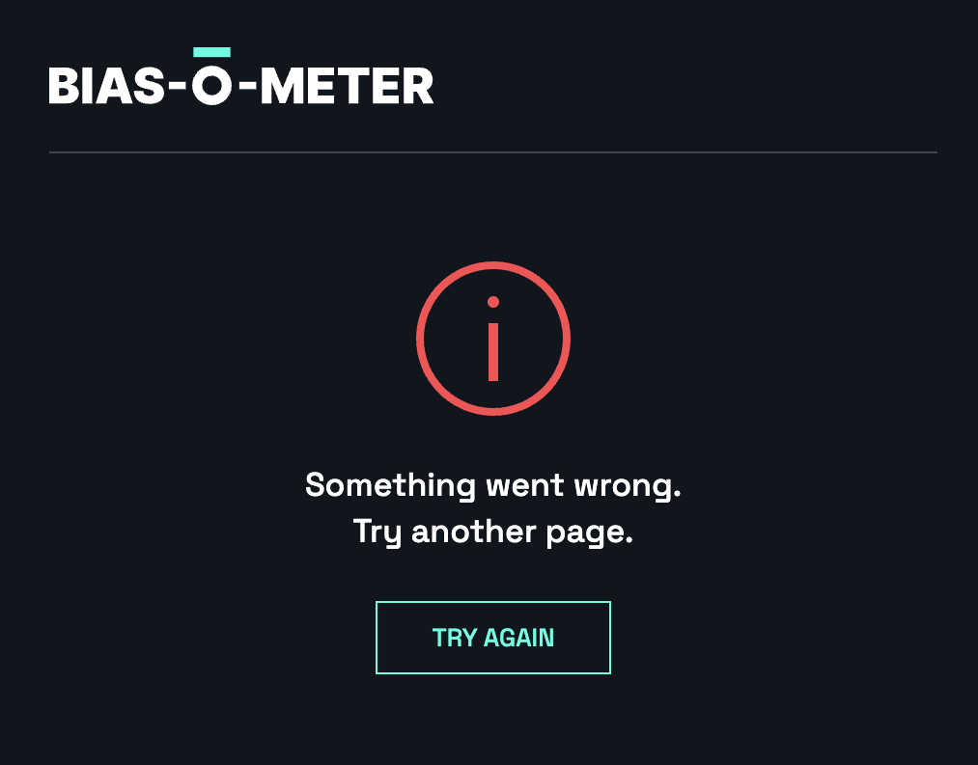
The initial pitfalls in practical work
- Some technical limitations by both tools:

Slide 20
Timeline of proposed activities
Compile the dataset of several dozen texts written in different countries, sources, and angles (12-24 hours).
Process them through two bias-detecting tools (24+ hours).
Analyse/Interpret the results (72+ hours).
Generate graphics (48-72 hours).
Explain why the disparities between results may arise (24-48 hours).
Write a document (72+ hours).

Slide 21
References
Anderson, M. (2022) An AI-Driven Bias Checker for News Articles, Available in Python. Available from: https://www.unite.ai/an-ai-driven-bias-checker-for-news-articles-available-in-python/) [Accessed 28 Jun 2023]
Berenson, L., Levine, D. & Szabat, K. (2015) Basic Business Statistics: Concepts and Applications. 13th Ed. Pearson
Bias-o-meter. Available from: https://bias-o-meter.optic.xyz/ [Accessed 3 Jul 2023]
Claydon, L.S. (2015) Rigour in quantitative research. Nursing Standard (2014+), 29(47), p.43.
D’Alonzo, S. & Tegmark, M. (2022) Machine-learning media bias. Plos one, 17(8), p.e0271947.
Dignum, V. (2020) Responsibility and artificial intelligence. The oxford handbook of ethics of AI, 4698, p.215.
HonestyMeter. Available from: https://www.honestymeter.com/ [Accessed 3 Jul 2023]
Gaur, M., Faldu, K. & Sheth, A. (2021) Semantics of the black-box: Can knowledge graphs help make deep learning systems more interpretable and explainable?. IEEE Internet Computing, 25(1), pp.51-59.
Hsu, T. & Lee Myers, S. (May 18, 2023) Another Side of the A.I. Boom: Detecting What A.I. Makes. The New York Times. Available from: https://www.nytimes.com/2023/05/18/technology/ai-chat-gpt-detection-tools.html [Accessed 28 Jun 2023]
Jang, W. J., Kim, J. Y., Lim, B. T., & Gim, G. Y. (2018). A study on data profiling based on the statistical analysis for big data quality diagnosis. International Journal of Advanced Science and Technology, 117, 77-88.
Kaliyar, R.K., Goswami, A. & Narang, P. (2021) FakeBERT: Fake news detection in social media with a BERT-based deep learning approach. Multimedia tools and applications, 80(8), pp.11765-11788.
Liu, Y., Ott, M., Goyal, N., Du, J., Joshi, M., Chen, D., Levy, O., Lewis, M., Zettlemoyer, L. & Stoyanov, V. (2019) RoBERTa: A robustly optimised BERT pretraining approach. arXiv preprint arXiv:1907.11692.
MTS Staff Writer (Apr 24, 2023) HonestyMeter: AI-Powered Pioneer for Unbiased Media Integrity and Transparency. Marketing Technology Insights. Available from: https://martechseries.com/predictive-ai/ai-platforms-machine-learning/honestymeter-ai-powered-pioneer-for-unbiased-media-integrity-and-transparency/ [Accessed 28 Jun 2023]
Oxford English Dictionary. Available from: http://www.oed.com/ [Accessed 3 Jul 2023]
Paullada, A., Raji, I.D., Bender, E.M., Denton, E. & Hanna, A. (2021) Data and its (dis) contents: A survey of dataset development and use in machine learning research. Patterns, 2(11).
PolitiFact. Available from: https://www.politifact.com/ [Accessed 3 Jul 2023]
Rashkin, H., Choi, E., Jang, J.Y., Volkova, S. & Choi, Y. (2017) Truth of varying shades: Analysing language in fake news and political fact-checking. In Proceedings of the 2017 conference on empirical methods in natural language processing (pp. 2931-2937).
Raza, S., Reji, D.J. & Ding, C. (2022) Dbias: detecting biases and ensuring fairness in news articles. International Journal of Data Science and Analytics, pp.1-21.
Thompson, D.F. (2018) Political ethics. International encyclopaedia of ethics.
UNESCO (21 Apr, 2023) Artificial Intelligence: examples of ethical dilemmas. Available from: https://www.unesco.org/en/artificial-intelligence/recommendation-ethics/cases [Accessed 4 Jul 2023]
Zyphur, M.J. & Pierides, D.C. (2017) Is quantitative research ethical? Tools for ethically practicing, evaluating, and using quantitative research. Journal of Business Ethics, 143, pp.1-16.

Slide 22
References for texts under experimentation
Aliaj, O. (Jul 4, 2023) Trump Media merger partner reveals $18mn preliminary settlement with SEC. Financial Times. Available from: https://www.ft.com/content/84ff4069-623d-41e2-99d2-08f3c0724c8d [Accessed 4 Jul 2023]
Caldwell, L. A., Dawsey, J. & Sanchez, Y.W. (Jul 1, 2023) Trump pressured Arizona Gov. Doug Ducey to overturn 2020 election. The Washington Post. Available from: https://www.washingtonpost.com/nation/2023/07/01/trump-2020-election-arizona-governor-doug-ducey/ [Accessed 4 Jul 2023]
CGTN News (Jun 27, 2023) China ratifies WTO deal on fishery subsidies. CGTN. Available from: https://news.cgtn.com/news/2023-06-27/China-ratifies-WTO-deal-on-fishery-subsidies-1kYTGFW7gac/index.html [Accessed 4 Jul 2023]
He, L. (Jul 4, 2023) China just played a trump card in the chip war. Are more export curbs coming? CNN. Available from: https://www.cnn.com/2023/07/04/tech/china-export-controls-semiconductor-war-explainer-intl-hnk/index.html [Accessed 4 Jul 2023]
Huynh, A. (Jun 25, 2023) Trump Campaigns in Michigan, a Battleground That’s Tinted Blue. The New York Times. Available from: https://www.nytimes.com/2023/06/25/us/politics/trump-republicans-michigan.html [Accessed 4 Jul 2023]
Kilander, G. (Jul 4, 2023) Truth Social SPAC agrees to SEC settlement as Trump’s past comments on indictment resurface. Independent. Available from: https://www.independent.co.uk/news/world/americas/us-politics/trump-news-indictment-desantis-truth-social-latest-b2368968.html [Accessed 4 Jul 2023]
Maruf, R. (Jul 3, 2023) SPAC seeking merger with Trump’s media company agrees to settlement with SEC. CNN. Available from: https://www.cnn.com/2023/07/03/business/trump-spac-sec-settlement-in-principle/index.html [Accessed 4 Jul 2023]
Ndegwa, S. (Sep 10, 2020) Trump hates black people. Period. CGTN. Available from: https://news.cgtn.com/news/2020-09-10/Trump-hates-black-people-Period--TFwAGRHdKM/index.html [Accessed 4 Jul 2023]
RT (Jul 2, 2023) LGBT Republicans slam DeSantis ad as ‘homophobic’. RT.com. Available from: https://www.rt.com/news/579106-desantis-video-homophobic-republicans-lgbt/ [Accessed 4 Jul 2023]
Smith, D. (May 13, 2023) As Trump’s lies and scandals deepen, the GOP responds as usual – with silence. The Guardian. Available from: https://www.theguardian.com/us-news/2023/may/13/trump-lies-republicans-congress-mccarthy-mcconnell [Accessed 4 Jul 2023]

